Slide 1
SIG AI
<welcome to>
Meeting 2: 03/07/24

Slide 2
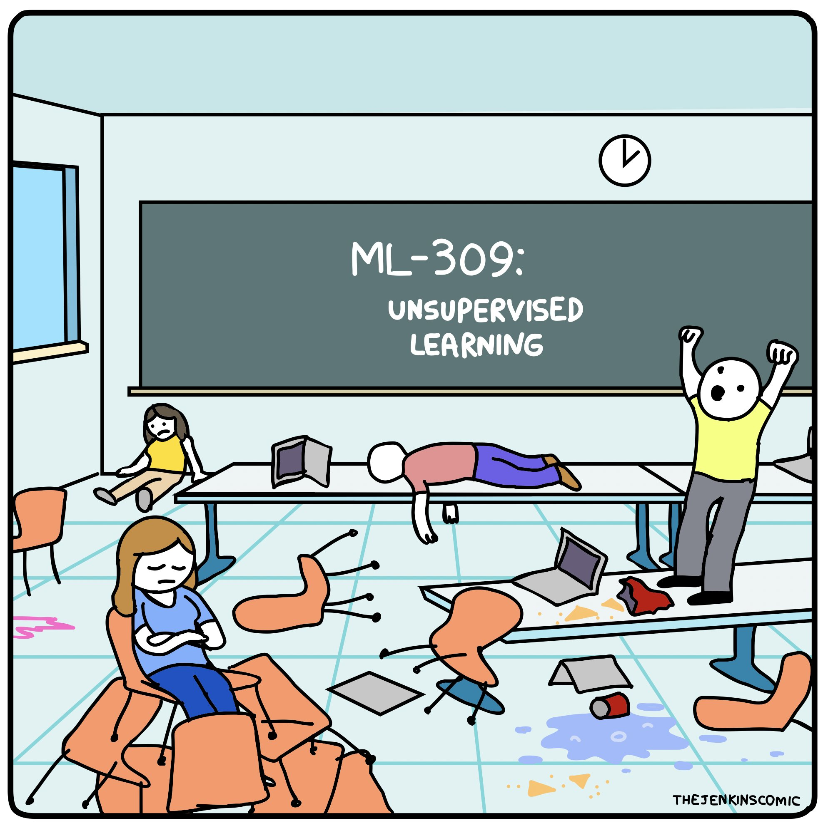

Slide 3
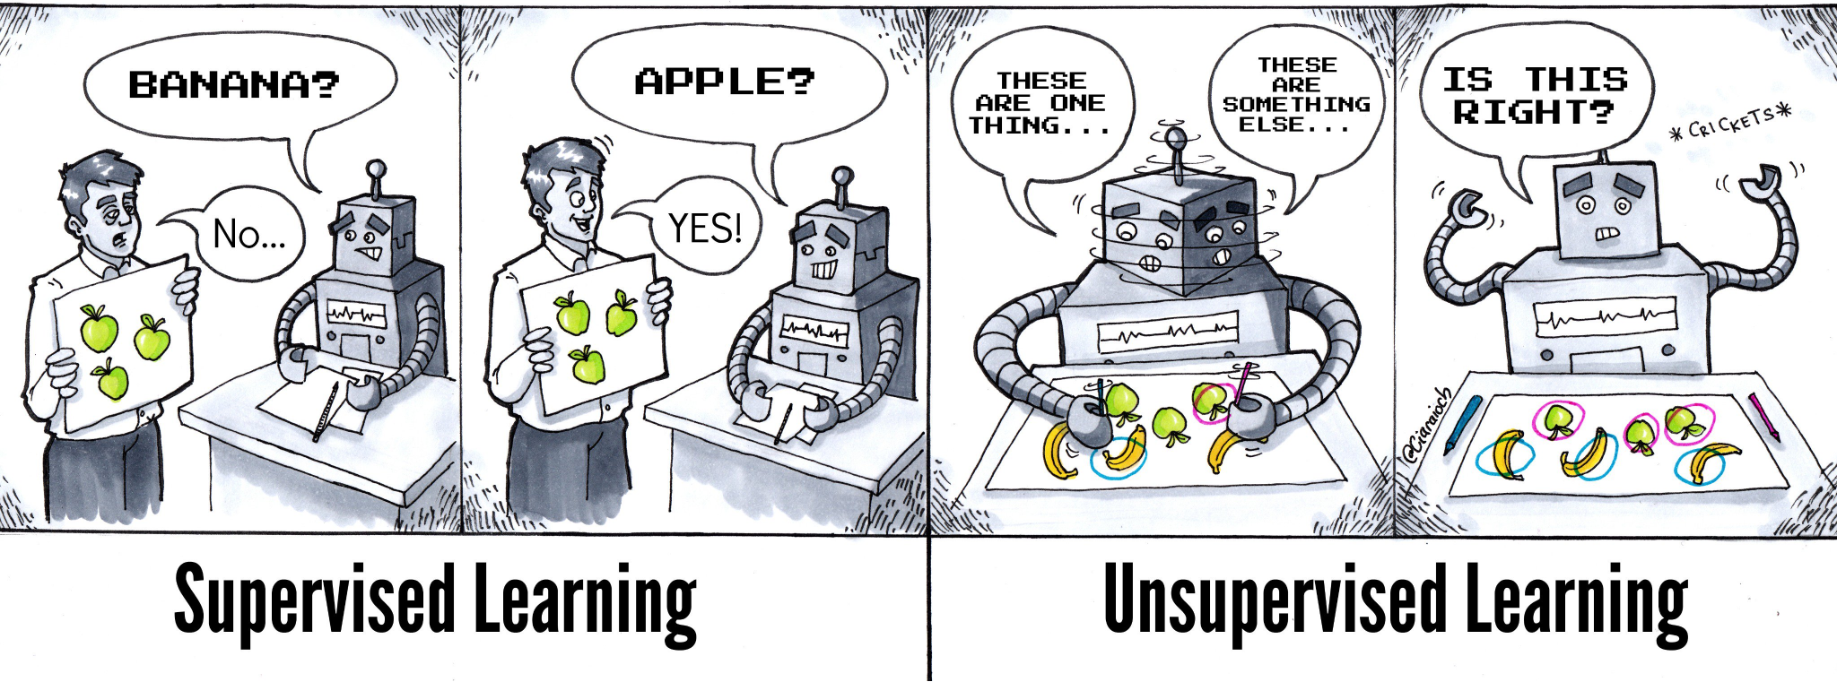

Slide 4
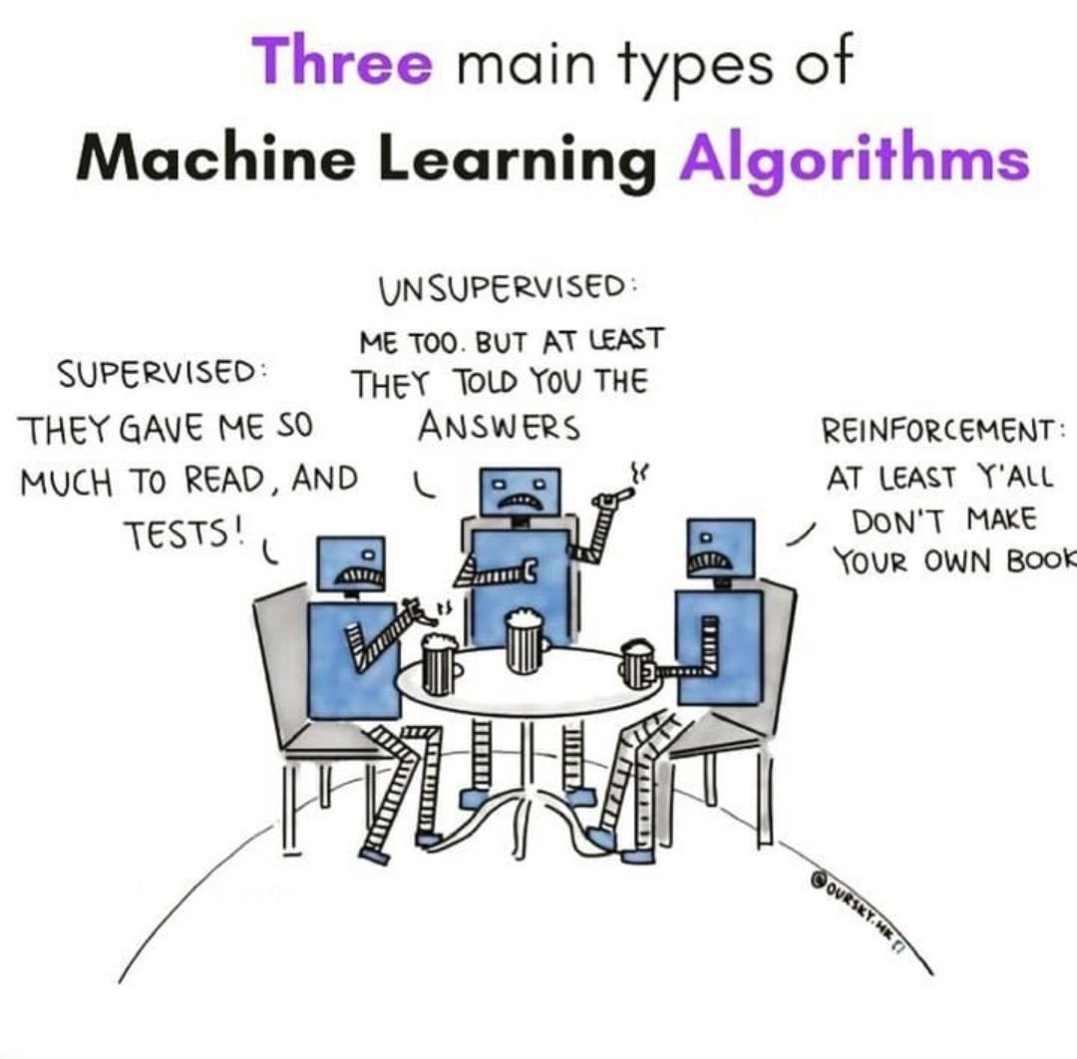

Slide 5
What is Unsupervised Learning?
Unsupervised learning in artificial intelligence is a type of machine learning that learns from data without human supervision. Unlike supervised learning, unsupervised machine learning models are given unlabeled data and allowed to discover patterns and insights without any explicit guidance or instruction.
Unsupervised learning algorithms are better suited for more complex processing tasks, such as organizing large datasets into clusters. They are useful for identifying previously undetected patterns in data and can help identify features useful for categorizing data.
Now, in what world is unlabelled raw data a good starting point, given we’re all about data engineering and pre-processing?

Slide 6
What use-case can you think of, where using unlabelled data might be beneficial?
Notes:
Removing/Identifying duplicates

Slide 7
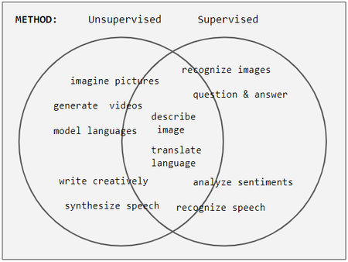
Supervised versus Unsupervised
Notes:
Why not just take the time to label data, provide employment to some data engineers, pre-processing engineers, and do supervised learning?
Although the division between is getting blurred by the day, it’s still different enough to be visible.
Tendency for a task to employ supervised vs. unsupervised methods. Task names straddling circle boundaries is intentional. It shows that the classical division of imaginative tasks (left) employing unsupervised methods is blurred in today's learning schemes.
– PICTURE –
What can we infer from this venn diagram? Unsupervised leans towards generating insights, not necessarily ‘an outcome’, like supervised learning.

Slide 8
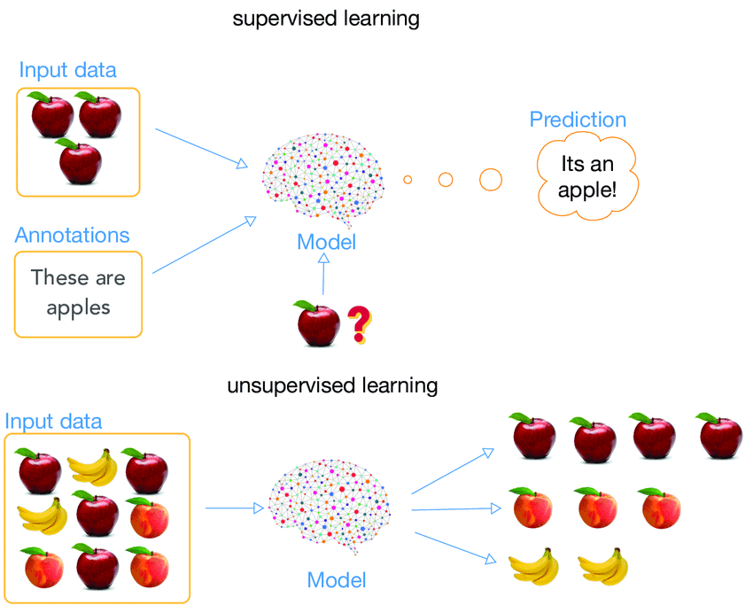
Supervised versus Unsupervised
Notes:
Why not just take the time to label data, provide employment to some data engineers, pre-processing engineers, and do supervised learning?
Although the division between is getting blurred by the day, it’s still different enough to be visible.
Tendency for a task to employ supervised vs. unsupervised methods. Task names straddling circle boundaries is intentional. It shows that the classical division of imaginative tasks (left) employing unsupervised methods is blurred in today's learning schemes.
– PICTURE –
What can we infer from this venn diagram? Unsupervised leans towards generating insights, not necessarily ‘an outcome’, like supervised learning.

Slide 9
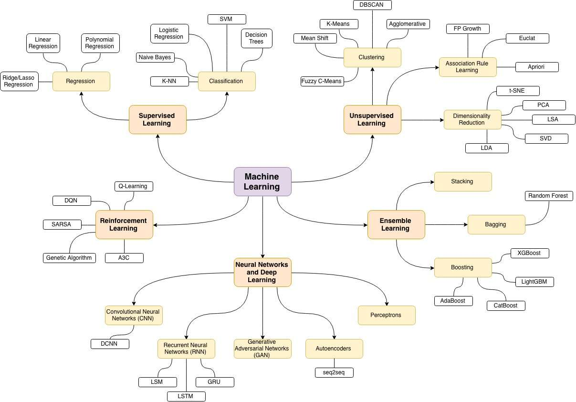

TODAY
Notes:
Ok, what are the different types?

Slide 10
What are we tackling today?

Slide 11
Ok, what are the different types?
Clustering
Association Rule
Learning
Dimensionality
Reduction
It is a technique used to group data points or items into several groups (clusters) based on the similarity of features. The goal is to partition the data into sets such that the data points in the same set are more similar to each other than to those in other sets. One popular method is K-Means clustering.
Real-world applications of clustering include customer segmentation, document clustering, and image segmentation.
It is a method for discovering interesting relations between variables in large databases. It’s a popular tool used for mining widespread relationships hidden in large data sets.
Real-world applications of associative rule learning include market basket analysis, web usage mining, and intrusion detection.
It is the process of reducing the number of random variables under consideration by obtaining a set of principal variables. It can be divided into feature selection and feature extraction. Principal Component Analysis (PCA) is a popular method for feature extraction.
Real-world applications of dimensionality reduction include image compression, simplifying machine learning tasks, and exploratory data analysis.

Slide 12
Ok, what are the different types?
Clustering
Association Rule
Learning
Dimensionality
Reduction
K-means
K-Means is a clustering algorithm that aims to partition n observations into k clusters in which each observation belongs to the cluster with the nearest mean.
Apriori
The Apriori algorithm is used for mining frequent itemsets and devising association rules in a transaction database. The algorithm uses a breadth-first search strategy to count the support of itemsets and uses a candidate generation function that exploits the downward closure property of support.
PCA
PCA is a dimensionality reduction technique that is often used to reduce the dimensionality of large data sets, by transforming a large set of variables into a smaller one that still contains most of the information in the large set.

Slide 13
Clustering
Clustering is a technique for exploring raw, unlabeled data and breaking it down into groups (or clusters) based on similarities or differences. It is used in a variety of applications, including customer segmentation, fraud detection, and image analysis. Clustering algorithms split data into natural groups by finding similar structures or patterns in uncategorized data.
Exclusive clustering: Data is grouped in a way where a single data point can only exist in one cluster. This is also referred to as “hard” clustering.
Overlapping clustering: Data is grouped in a way where a single data point can exist in two or more clusters with different degrees of membership. This is also referred to as “soft” clustering.
Hierarchical clustering: Data is divided into distinct clusters based on similarities, which are then repeatedly merged and organized based on their hierarchical relationships.
Probabilistic clustering: Data is grouped into clusters based on the probability of each data point belonging to each cluster.
Notes:
Exclusive clustering: Data is grouped in a way where a single data point can only exist in one cluster. This is also referred to as “hard” clustering.
Overlapping clustering: Data is grouped in a way where a single data point can exist in two or more clusters with different degrees of membership. This is also referred to as “soft” clustering.
Hierarchical clustering: Data is divided into distinct clusters based on similarities, which are then repeatedly merged and organized based on their hierarchical relationships.
Probabilistic clustering: Data is grouped into clusters based on the probability of each data point belonging to each cluster.

Slide 14
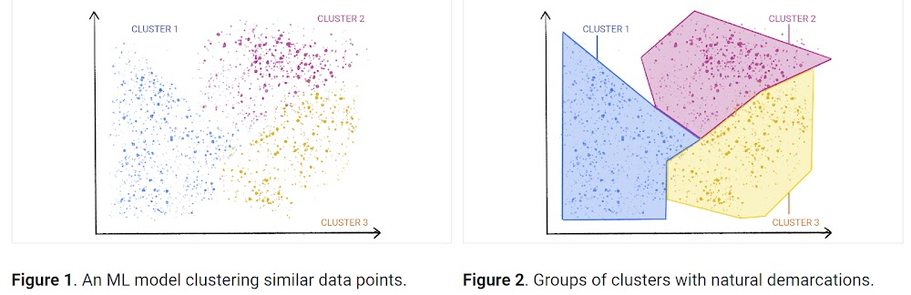
Clustering

Slide 15
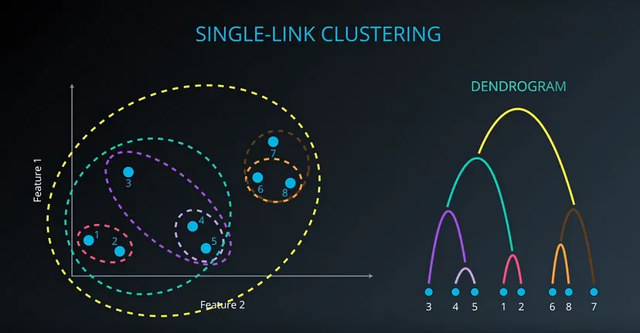
Clustering
Notes:
Multi-layered
Nested clusters
Deep-hierarchies

Slide 16
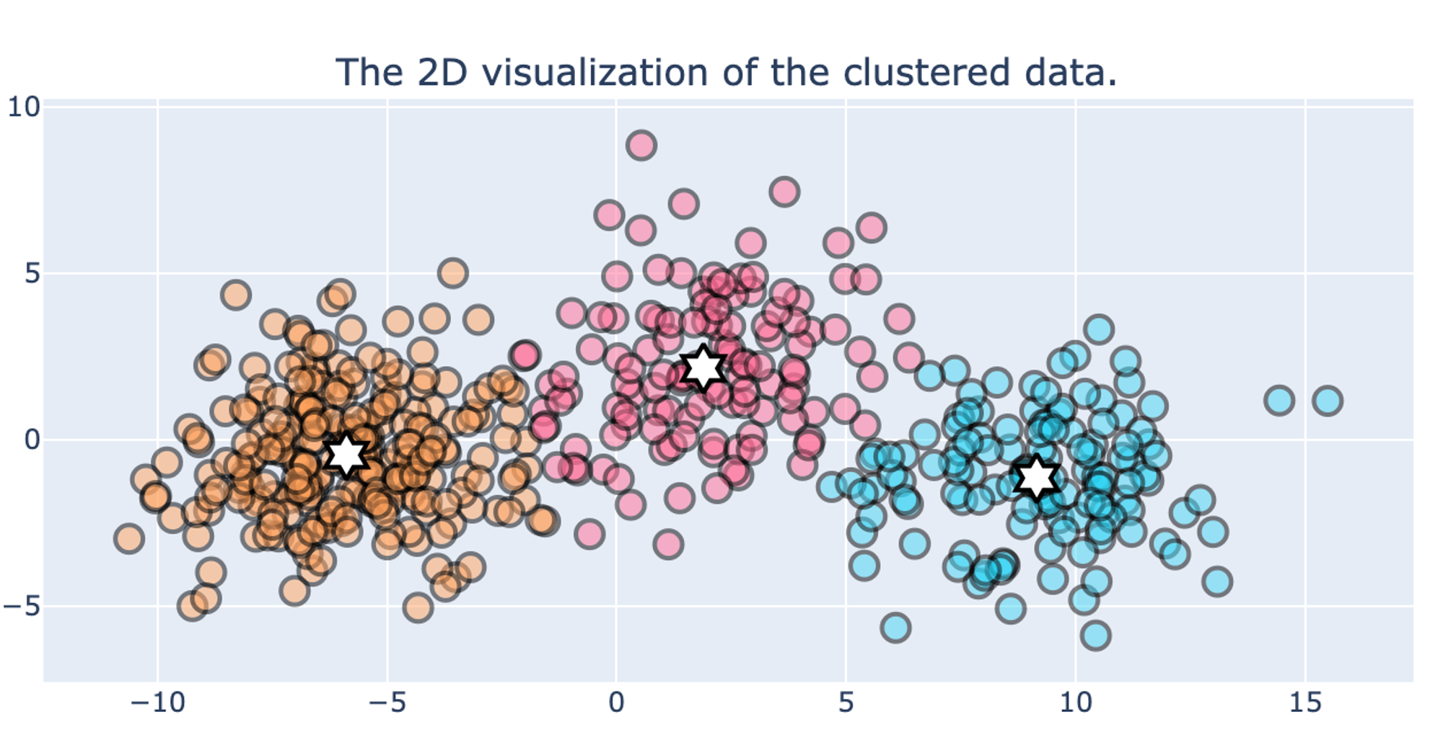
Clustering
Notes:
Multi-layered
Nested clusters
Deep-hierarchies

Slide 17
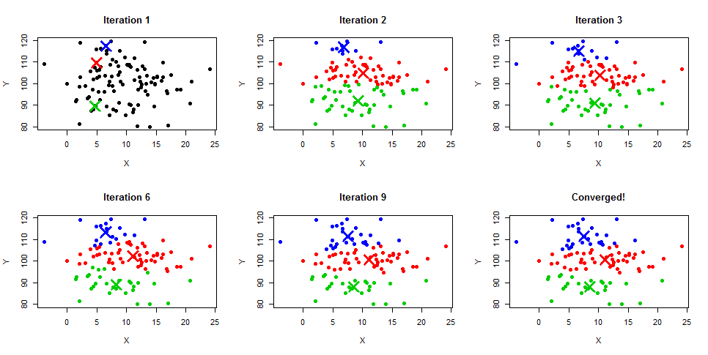
K-means
K-Means clustering algorithm is easily the most popular and widely used, primarily because of the intuition and the ease of implementation. It is a centroid-based algorithm where the user must define the required number of clusters it wants to create.
K-Means clustering is an iterative algorithm that creates non-overlapping clusters meaning each instance in your dataset can only belong to one cluster exclusively.
Notes:
Imagine you’re a teacher at a school and you have a bunch of students that you need to divide into groups for a project. You don’t know anything about their skills or interests, but you want to make sure the groups are balanced. So, you decide to group them based on their height. You randomly pick a few students (the same number as the groups you want) and measure their heights. These are your initial “centroids”. Then, you measure the height of all other students and assign each one to the group of the closest centroid. After everyone is assigned, you find a new average height for each group and that becomes your new centroid. You repeat this process until the centroids don’t change much anymore. That’s K-Means clustering!
– centroid based : prones to outlier errors

Slide 18
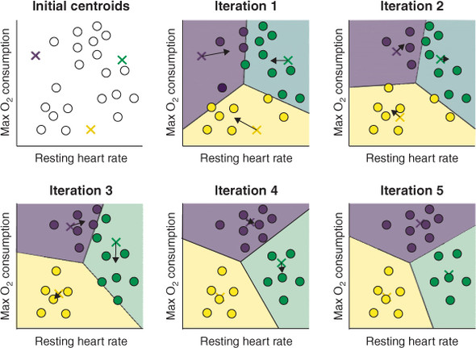
What do we mean by centroid based?
Imagine you have a bunch of points on a 2D plane. You want to group these points into ‘K’ number of clusters. You start by randomly picking ‘K’ points on this plane. These points are your initial ‘centroids’. Then, for each point on the plane, you calculate its distance to all the centroids and assign it to the cluster of the closest centroid. Now, you have your initial clusters.
But, these clusters might not be optimal. So, you calculate the mean (average) position of all points in each cluster and move the centroid to that mean position. This might change the cluster assignment of some points. So, you repeat the process of assigning points to the closest centroid and recalculating the centroids until the centroids don’t change anymore (or change very little). That’s when you say the algorithm has ‘converged’ and your clusters are ready.
Notes:
Imagine you’re a teacher at a school and you have a bunch of students that you need to divide into groups for a project. You don’t know anything about their skills or interests, but you want to make sure the groups are balanced. So, you decide to group them based on their height. You randomly pick a few students (the same number as the groups you want) and measure their heights. These are your initial “centroids”. Then, you measure the height of all other students and assign each one to the group of the closest centroid. After everyone is assigned, you find a new average height for each group and that becomes your new centroid. You repeat this process until the centroids don’t change much anymore. That’s K-Means clustering!

Slide 19
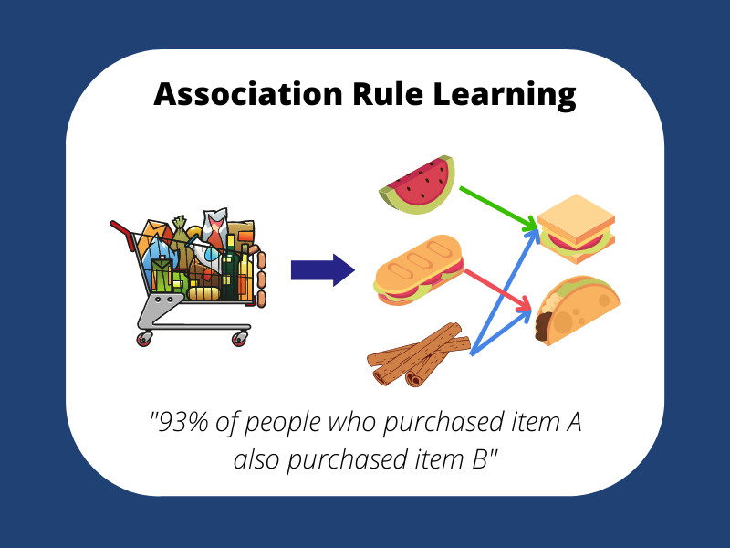
Association Rule Learning
This type of unsupervised machine learning takes a rule-based approach to discovering interesting relationships between features in a given dataset. It works by using a measure of interest to identify strong rules found within a dataset.
We typically see association rule mining used for market basket analysis: this is a data mining technique retailers use to gain a better understanding of customer purchasing patterns based on the relationships between various products.

Slide 20
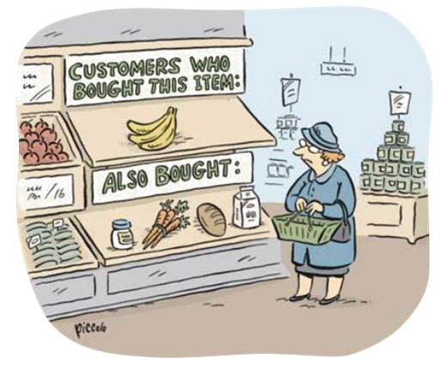
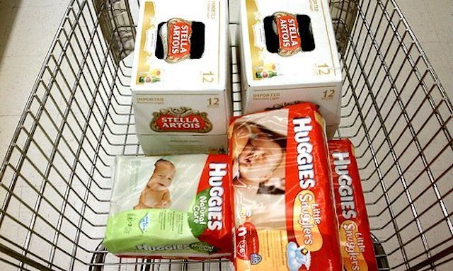
Association Rule Learning
Notes:
My personal favorite is: Beers and Diapers!
Researchers discovered that customers who buy diapers also tend to buy beer. This classic example shows that there might be many interesting association rules hidden in our daily data.

Slide 21
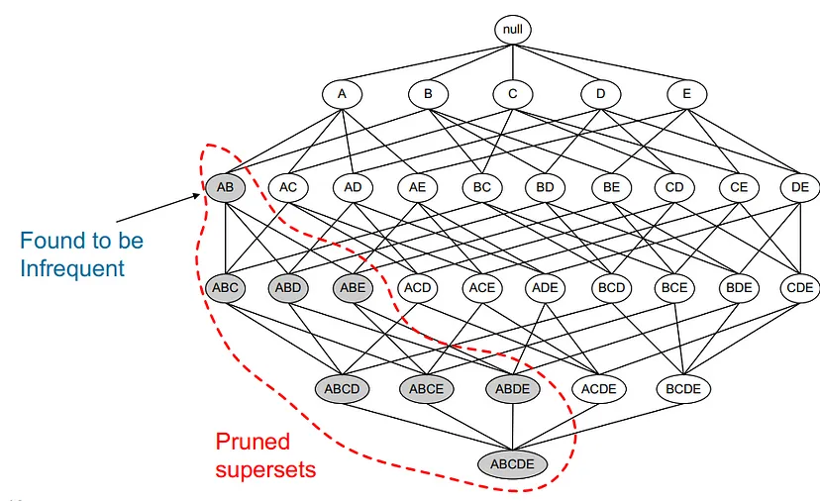
Apriori
The main idea of Apriori is
All non-empty subsets of a frequent itemset must also be frequent.
It’s a bottom-up approach. We started from every single item in the itemset list. Then, the candidates are generated by self-joining. We extend the length of the itemsets one item at a time. The subset test is performed at each stage and the itemsets that contain infrequent subsets are pruned. We repeat the process until no more successful itemsets can be derived from the data.
Notes:
In simple terms, let’s say you’re in a supermarket and you notice that whenever a customer buys bread, they also buy butter. This means that the itemset {bread, butter} is frequent. According to the Apriori property, all non-empty subsets of this itemset, which are {bread} and {butter}, must also be frequent. This means that bread and butter are also frequently bought items on their own.
The Apriori property is used to improve the efficiency of the Apriori algorithm. It helps reduce the search space by allowing the algorithm to ignore certain itemsets. Specifically, if an itemset is found to be infrequent, then according to the Apriori property, all its supersets (i.e., itemsets that contain this itemset) will also be infrequent and can be ignored. This significantly speeds up the algorithm when dealing with large datasets.

Slide 22
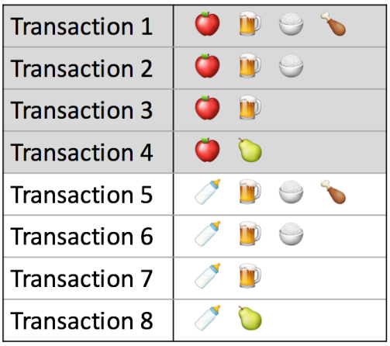
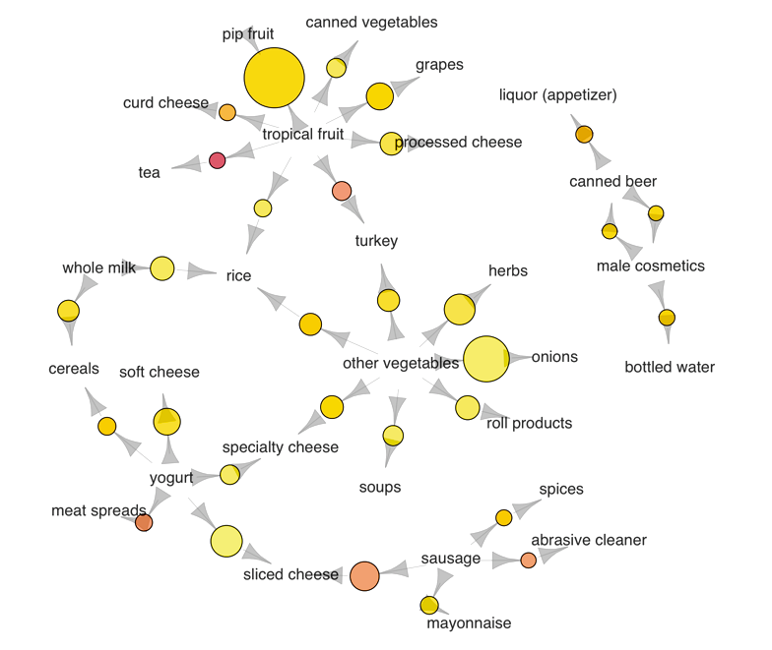
Apriori

Slide 23
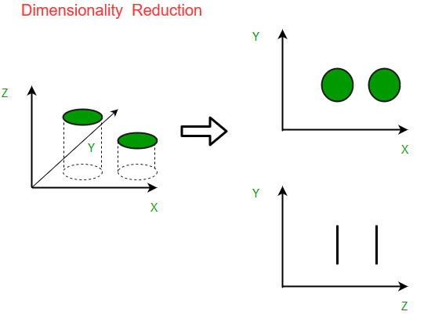
Dimensionality Reduction
Dimensionality reduction is simply, the process of reducing the dimension of your feature set. Your feature set could be a dataset with a hundred columns (i.e features) or it could be an array of points that make up a large sphere in the three-dimensional space. reduces the number of features, or dimensions, in a dataset. More data is generally better for machine learning, but it can also make it more challenging to visualize the data.
Dimensionality reduction extracts important features from the dataset, reducing the number of irrelevant or random features present.
Notes:
A machine learning model that is trained on a large number of features, gets increasingly dependent on the data it was trained on and in turn overfitted, resulting in poor performance on real data, beating the purpose.
Dimensionality reduction is bringing the number of columns down to say, twenty or converting the sphere to a circle in the two-dimensional space.
Avoiding overfitting is a major motivation for performing dimensionality reduction. The fewer features our training data has, the lesser assumptions our model makes and the simpler it will be.

Slide 24
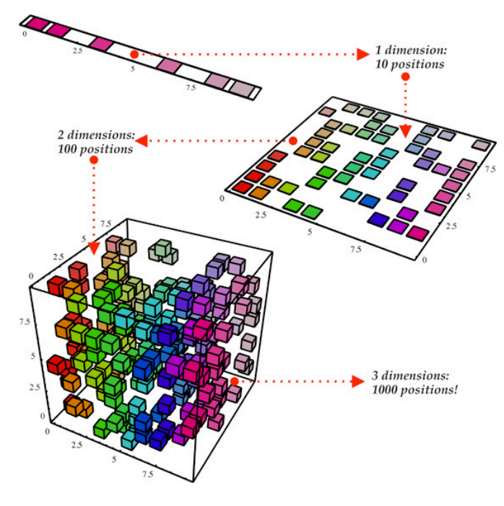
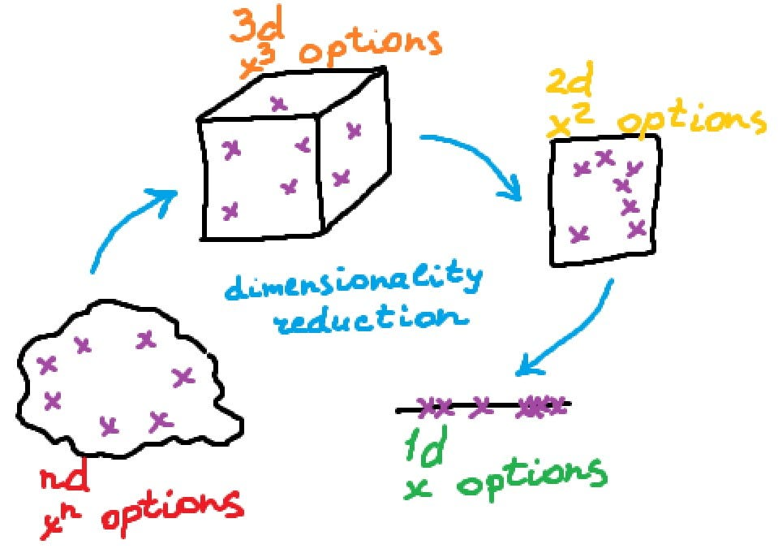
Dimensionality Reduction

Slide 25
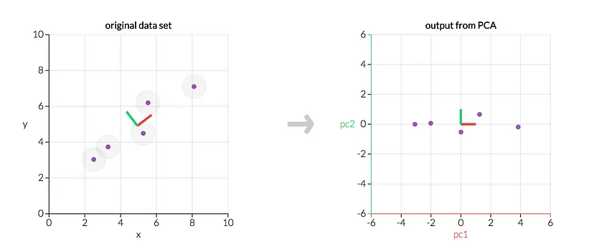
PCA
Principal component analysis, or PCA, is a dimensionality reduction method that is often used to reduce the dimensionality of large data sets, by transforming a large set of variables into a smaller one that still contains most of the information in the large set.
Principal component analysis is a technique for feature extraction — so it combines our input variables in a specific way, then we can drop the “least important” variables while still retaining the most valuable parts of all of the variables!
As an added benefit, each of the “new” variables after PCA are all independent of one another. This is a benefit because the assumptions of a linear model require our independent variables to be independent of one another. If we decide to fit a linear regression model with these “new” variables (see “principal component regression” below), this assumption will necessarily be satisfied.
Notes:
You might ask the question, “How do I take all of the variables I’ve collected and focus on only a few of them?” In technical terms, you want to “reduce the dimension of your feature space.” By reducing the dimension of your feature space, you have fewer relationships between variables to consider and you are less likely to overfit your model. (Note: This doesn’t immediately mean that overfitting, etc. are no longer concerns — but we’re moving in the right direction!)
Somewhat unsurprisingly, reducing the dimension of the feature space is called “dimensionality reduction.”
Imagine you’re a bird watcher and you have a lot of information about different bird species - their weight, wingspan, beak length, feather color, etc. But it’s hard to compare all these features at once. So, you decide to simplify things. You notice that heavier birds usually have larger wingspans and longer beaks. So, instead of looking at these features separately, you combine them into one new feature - let’s call it “size”. Now, you can compare birds just based on their “size” and “feather color”. This is what dimensionality reduction does - it simplifies data by combining features into fewer, more meaningful ones.

Slide 26
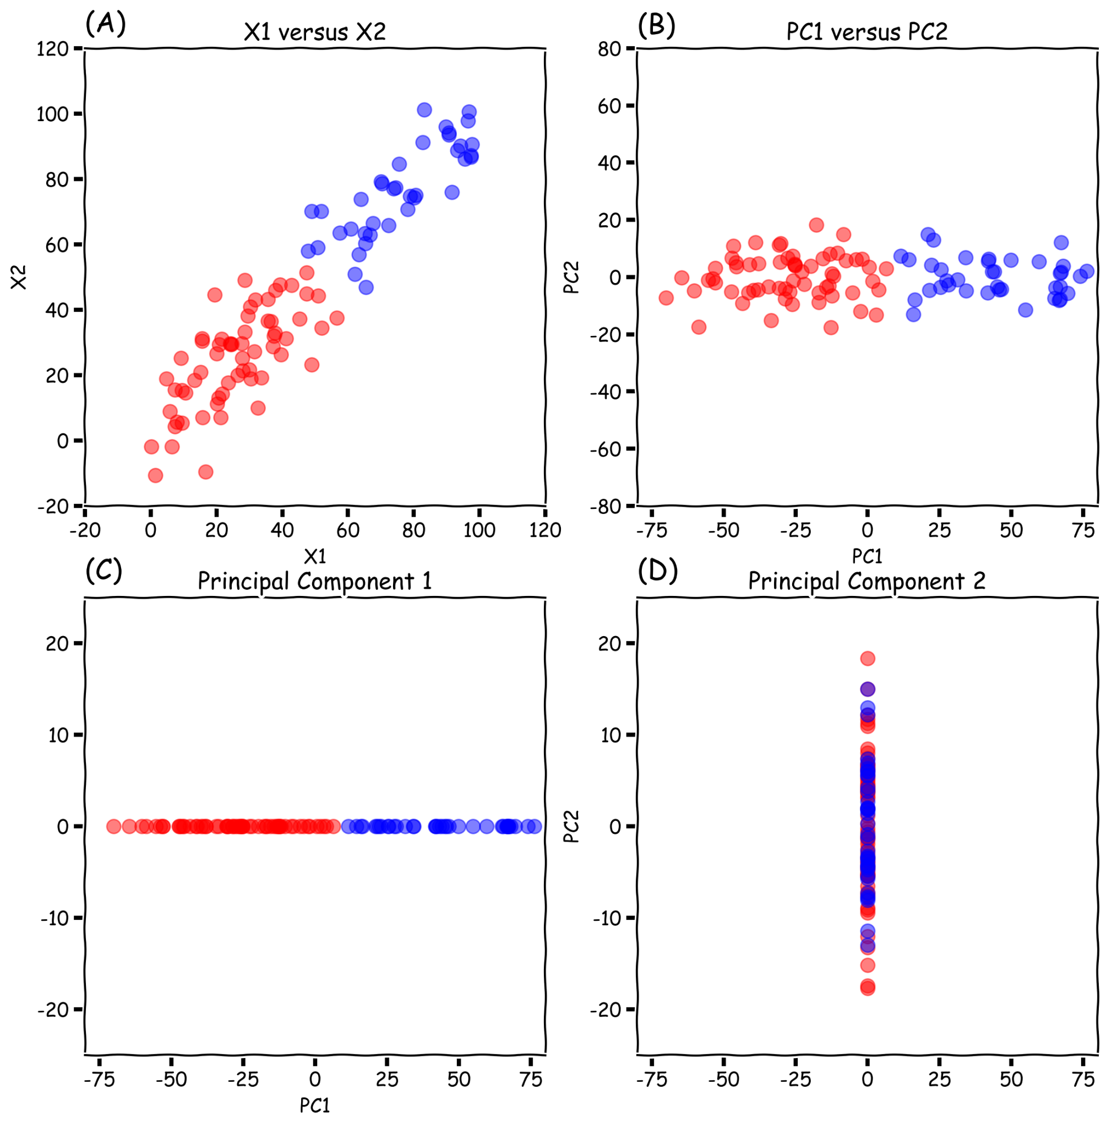
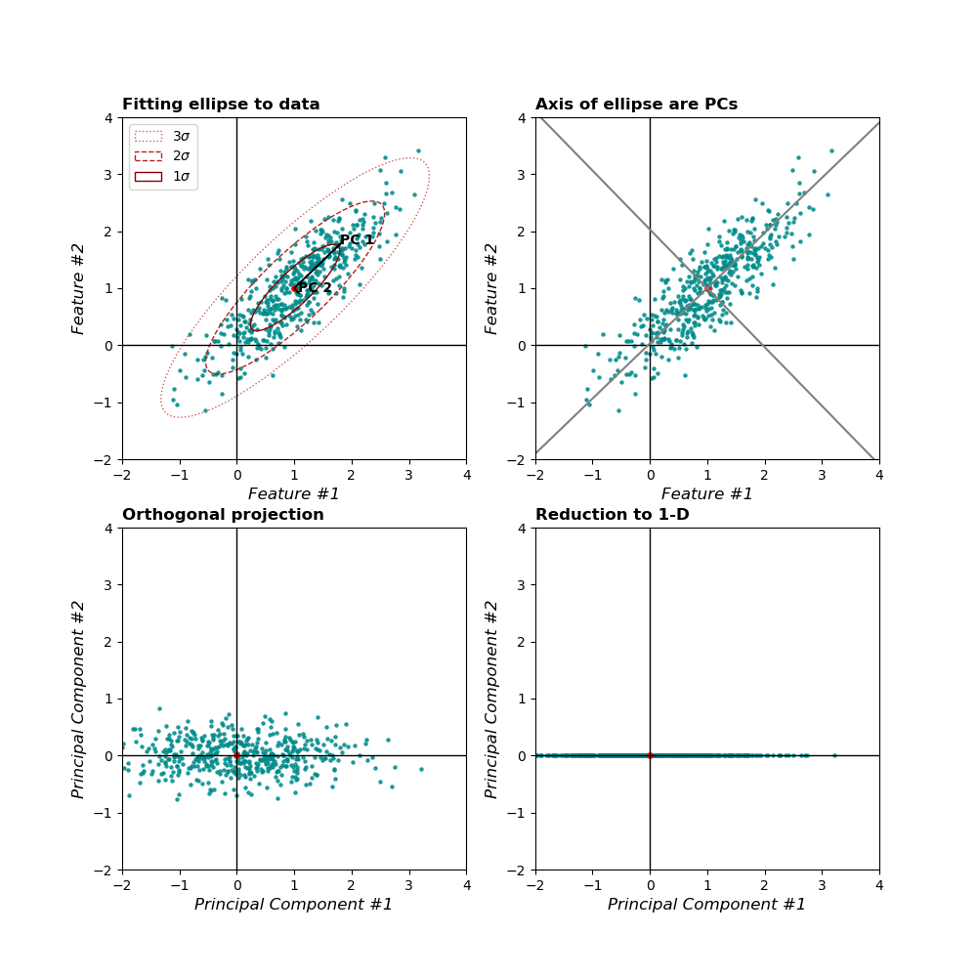
PCA
Notes:
You might ask the question, “How do I take all of the variables I’ve collected and focus on only a few of them?” In technical terms, you want to “reduce the dimension of your feature space.” By reducing the dimension of your feature space, you have fewer relationships between variables to consider and you are less likely to overfit your model. (Note: This doesn’t immediately mean that overfitting, etc. are no longer concerns — but we’re moving in the right direction!)
Somewhat unsurprisingly, reducing the dimension of the feature space is called “dimensionality reduction.”

Slide 27

PCA
As there are as many principal components as there are variables in the data, principal components are constructed in such a manner that the first principal component accounts for the largest possible variance in the data set. For example, let’s assume that the scatter plot of our data set is as shown below, can we guess the first principal component ? Yes, it’s approximately the line that matches the purple marks because it goes through the origin and it’s the line in which the projection of the points (red dots) is the most spread out. Or mathematically speaking, it’s the line that maximizes the variance (the average of the squared distances from the projected points (red dots) to the origin).

